Slide 1
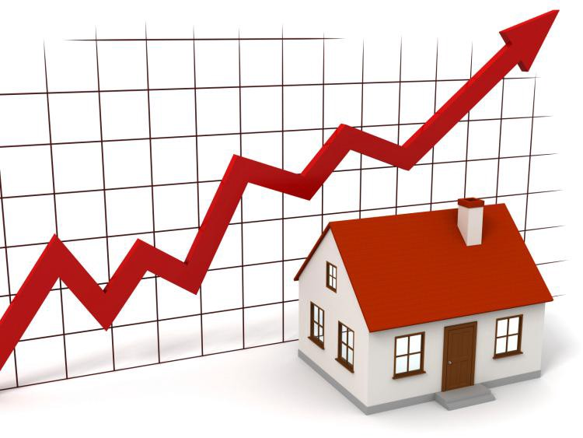
House Price Predcition
BY
K. Naveen Varma

Slide 2
Introduction Of Project:
A US-based housing company named Surprise Housing has decided to enter the Australian market.
The company is looking at prospective properties to buy houses to enter the market.
You are required to build a model using Machine Learning in order to predict the actual value of the prospective properties and decide whether to invest in them or not.
For this company wants to know:
Which variables are important to predict the price of variable?
How do these variables describe the price of the house?

Slide 3
Problem Statement:
It required to model the price of houses with the available independent variables.
This model will then be used by the management to understand how exactly the prices vary with the variables.
They can accordingly manipulate the strategy of the firm and concentrate on areas that will yield high returns.
Further, the model will be a good way for the management to understand the pricing dynamics of a new market.

Slide 4
Data Analysis:
The Dataset Contains a Data of 1168 entries each having 81 variables, in which some are numerical Data and some are Categorical Data
As the Data having two datasets 1. Train Data, 2. Test Data
Check the info of the data using the info() function
From the above function I analyze the dataset having float varaibles -3 int-35 and object-43 so total of 81 variables.
Next Step is EDA……..(Exploratory Data Analysis)

Slide 5
Exploratory Data Analysis:
In EDA we need to Pre-process the Data and Visualization:
Steps include in Pre-Processing Data are
1)Data Cleaning: - Removing Outliers, Skewness and imputing Missing Values.
2)Data Transformation: - like Normalization by applying normalization we can improve the accuracy and efficiency of the models. And also reduce the errors.
3)Data Reduction: By Reducing the no of features by Feature Selection Process, PCA And VIF
1.Data Cleaning: As a Part of EDA we need to do Data cleaning so firstly we need to check any null values in our data, From the below image shows we don’t have any null values, so no need to impute any data

Slide 6
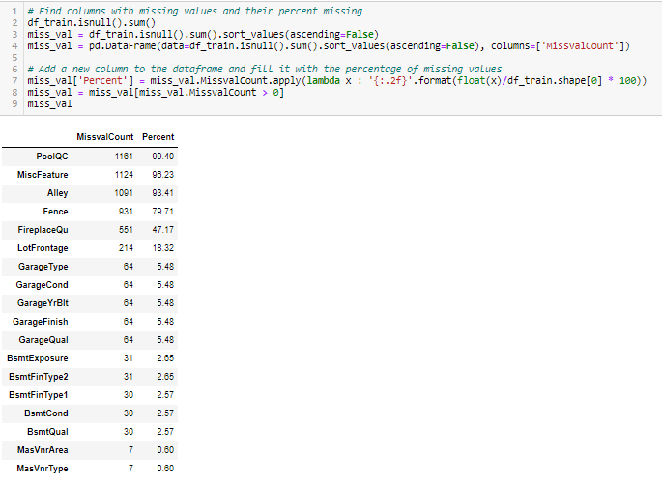
First Step of Data Cleaning is Checking Any null Values in our Data set
For this we used the function
The Dataset Having the null values and I am removing the columns which is having the percentage more than 45%.
By comparing both train and test data column PoolQC, MiscFeature, Alley, Fence, FireplaceQu having more than 45% data is missing.so removing from data set and remaining all very small percent so fill the null values
For the remaining missing values , we need to use the impute method
For need to know how many unique values are there with the count by using this formula

Slide 7
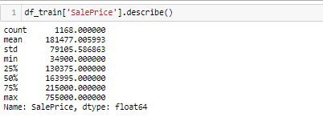
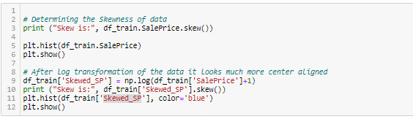
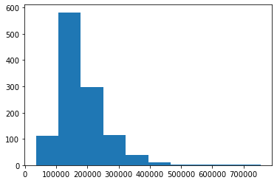
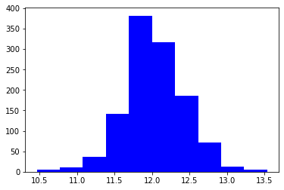
As it shows the 75% and Max having so much difference so our column is rightly skewed...so do skewing for plotting with variables
Skew for the variable is 1.98
Before Skew After Skew
Skew for the variable is 1.98

Slide 8
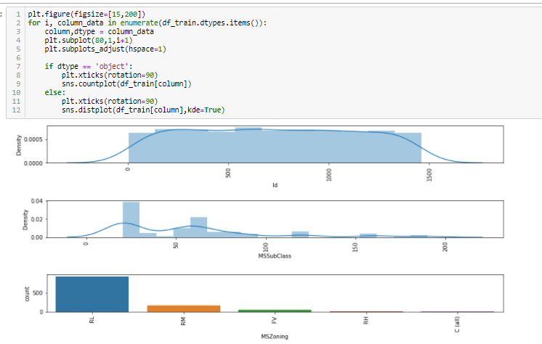
Visualisation:
We Analyze the variables using the countplot for categorical the variables and distplot for numerical variables

Slide 9
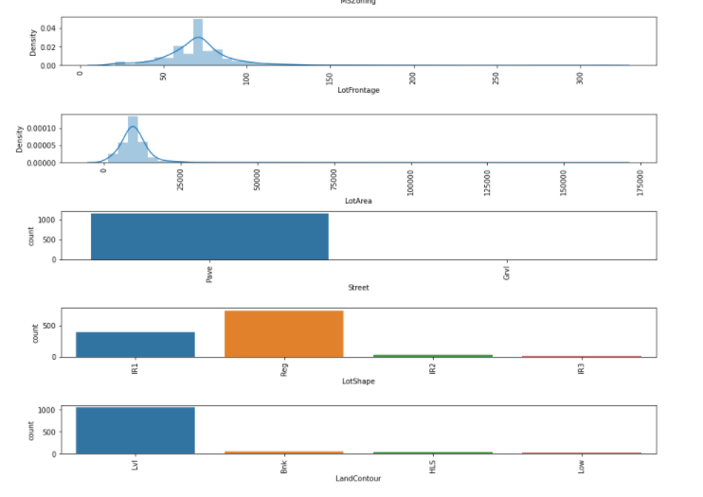
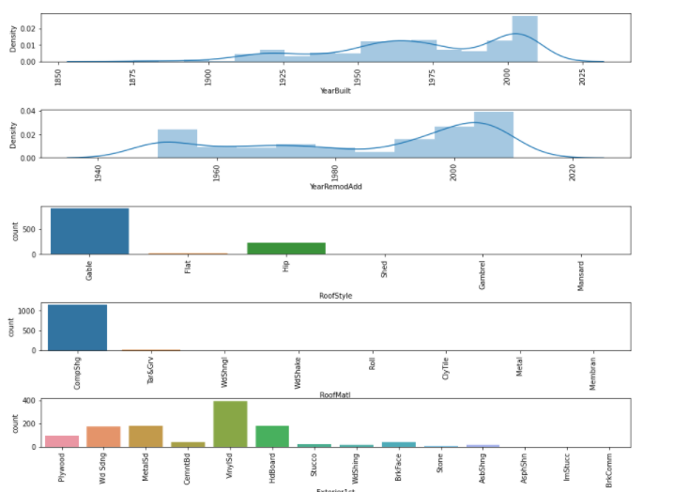
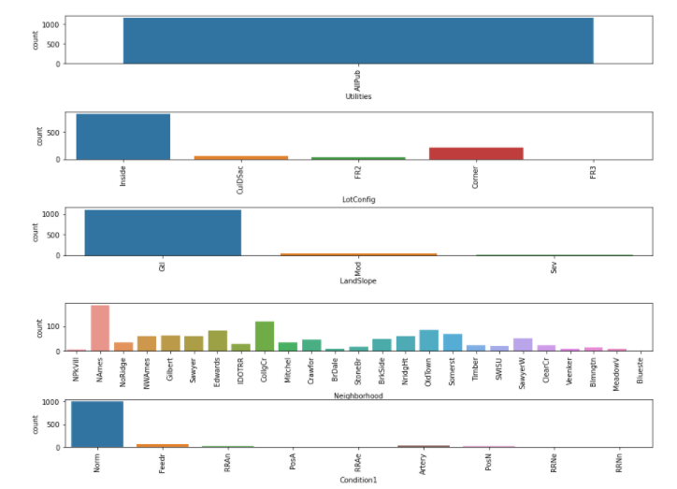
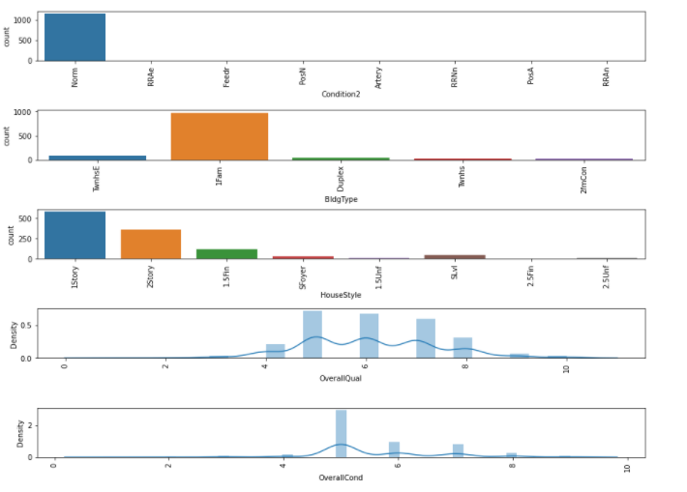
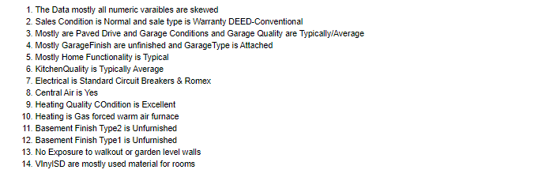

Slide 10
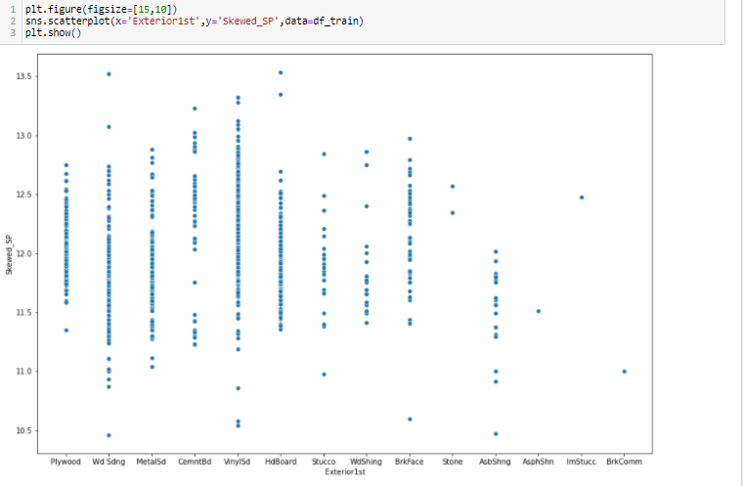
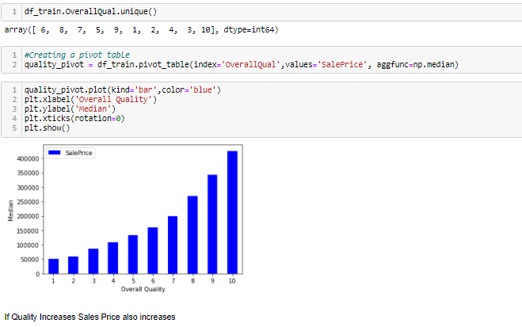
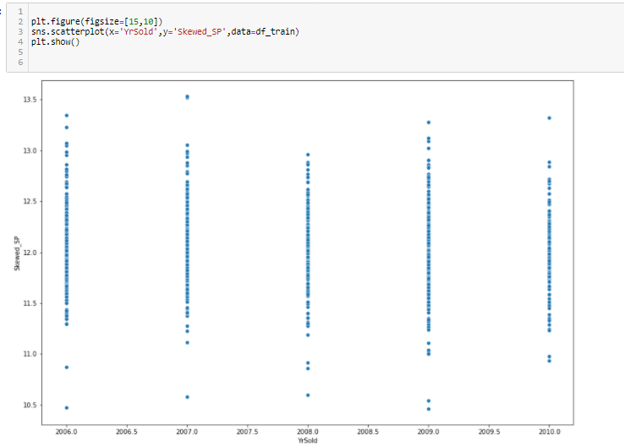

Slide 11
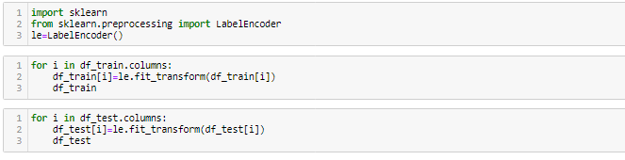
After the visualization we need to convert all the categorical variables into
numerical variables for further Analysis ,so for converting need to use the
Label Encoder
As per the describe analysis, need to drop some more variables to make our model is accurate
df_train=df_train.drop(['SalePrice', 'Id','Utilities','GarageArea','WoodDeckSF','LowQualFinSF','YearBuilt','YearRemodAdd','GrLivArea','GarageYrBlt','EnclosedPorch','3SsnPorch','PoolArea','MiscVal','LandSlope','LandContour','GarageQual','GarageCond','PavedDrive','ScreenPorch','MSZoning','Street','Condition1','Condition2','BldgType','RoofStyle','RoofMatl','ExterCond','BsmtFinType2','BsmtFinSF2','Heating','CentralAir','Electrical','BsmtHalfBath','KitchenAbvGr','Functional','SaleType','SaleCondition'], axis=1)

Slide 12
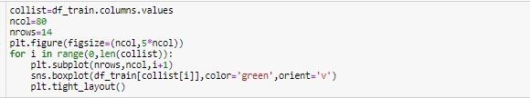
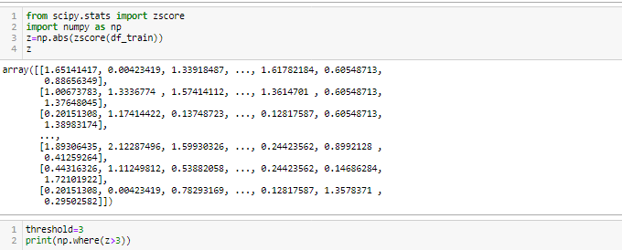
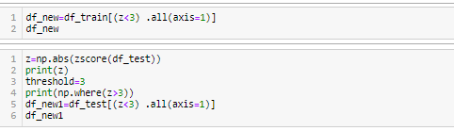
By using the boxplot method just check any outliers and then remove the outliers by using z-score method

Slide 13
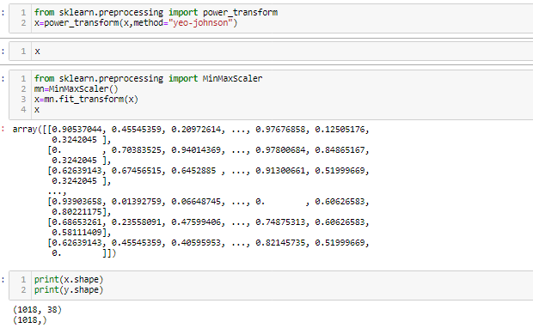
Skewness of Data:
As of our numeric data is skewed we need to do normalization before go for training and testing for that need to check the skewness of data if our data is Greater than 0.5% in both positive and negative sides ,then need to do power transformation and do scaling
Scaling are of two types:
1.Standard Scaler: Standard scalar standardizes features of the data set by scaling to unit variance and removing the mean (optionally) using column summary statistics on the samples in the training set.
MIN-MAX Scaler: MinMaxScaler. For each value in a feature, MinMaxScaler subtracts the minimum value in the feature and then divides by the range. The range is the difference between the original maximum and original minimum. MinMaxScaler preserves the shape of the original distribution.

Slide 14
Modelling :
We know that this is Regression problem so we use R_2 score , MAE, MSE and RMSE as our eveluation matrix. We also see the cross validated score.
As we know, this dateset has a lot of categorical features so before doing the modeling part first we have to change features data type.
We also do feature scaling to scale down the data.
First we see the result without doing hyper-parameter tuning.
We also use several models as our evaluation model without using hyper-parameter tuning and see their result and after that we do hyper-parameter tuning and compare both the result that which one gives better R_2 score.

Slide 15
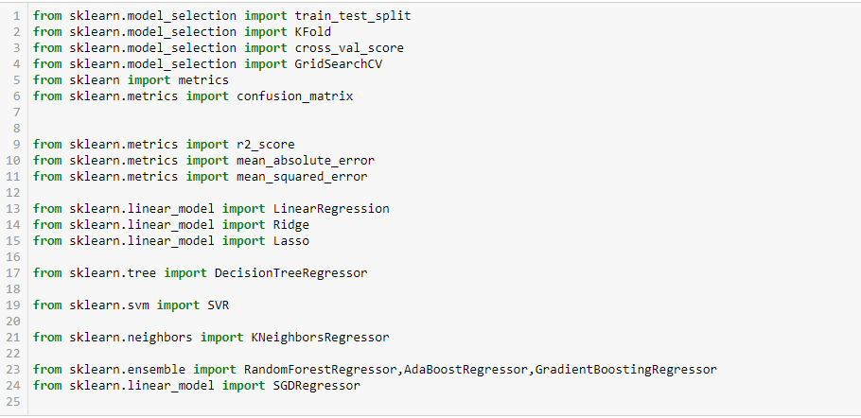
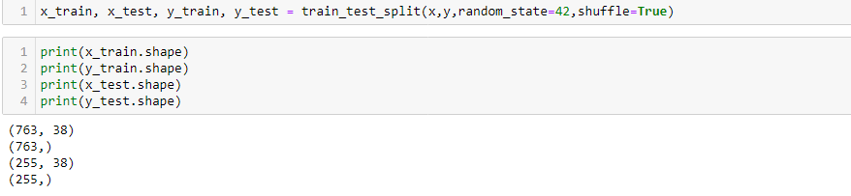
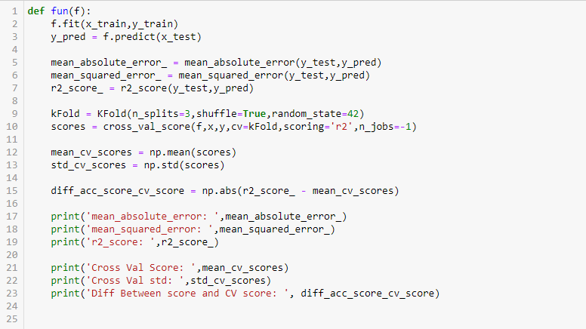
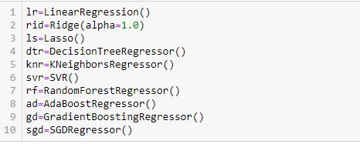

Slide 16
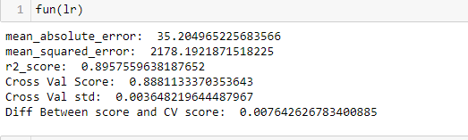
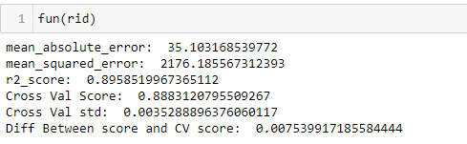
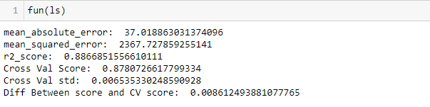
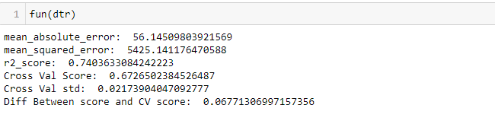
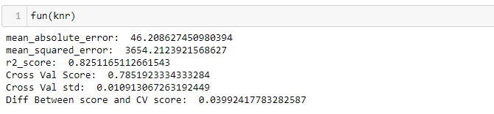
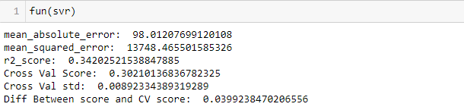
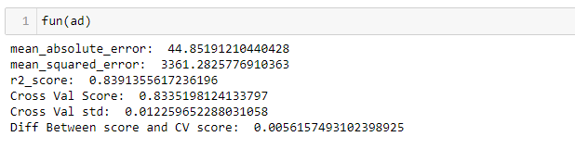
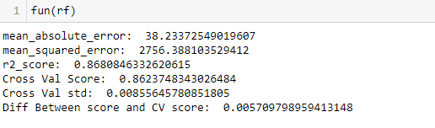

Slide 17
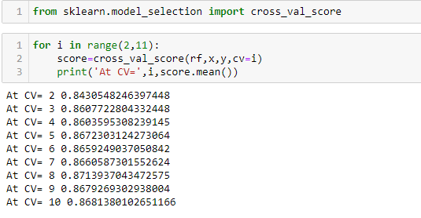
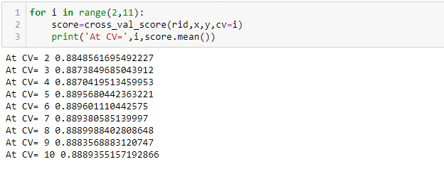
Cross Validation: - This technique is used to check weather out data set is over fitting or under fitting. If model score is high and cv score is less it means model perform well in train dataset but did not perform well in unseen or test dataset. Feature selection is the best way to overcome the overfitting problem. There are 3 ways for the validation. KFold Cross validation score, Hold Out Methods and LOOCV.
KFold: - In this technique it will rotate the data into the k-fold times.
LOOCV: Leave one out cross validation It will take one row for test and remaining for training so each and every row go for test so its time-consuming processing

Slide 18
Conclusion And Remarks:
From this model we can predict the House price prediction of different variables how the prices are varying according to that each one can take their prescribed house.
We used different regression methods to test the process of the model like Linear Regression, Decision tree Regression, Lasso Regression, Ridge Regression and Ada boosting Regression, Random Forest Regression, Gradient Regression, SGD Regression .
We get good score in Ridge Regressor got r2_score of 89.58% on training data, mean absolute error is 35.10% , Diff Between score and validation score also nice but not in 1st position but comparatively with all the variables and cross validation value also is high in Ridge Regressor .the model performance is excellent.

Slide 19
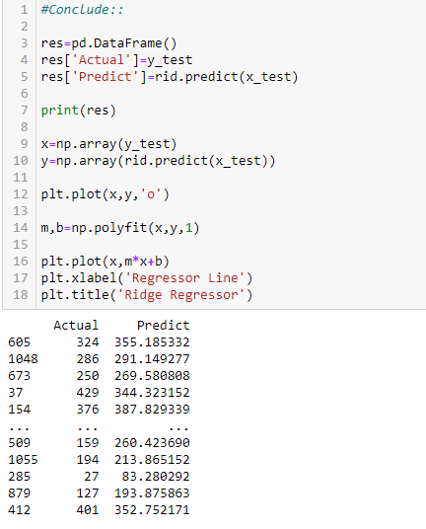
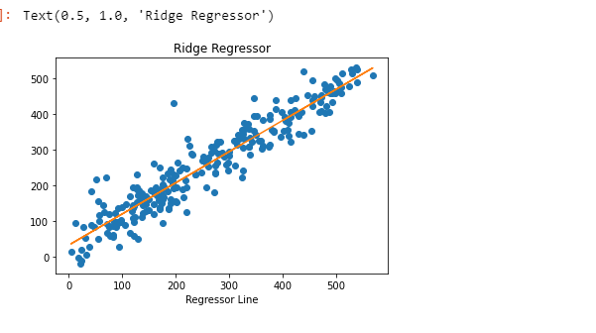

Finalize The Model
After we analyze the model the Ridge Model gives me the better result when comparing mean absolute error, mean squared error ,R2_score and cross validation
We further proceed to test the object that we saved using pickle, and create a data frame of predicted values

Slide 20
Conclusion :
We make a machine learning model in order to improve the selection of of place and decide price.
Our Visualization also help them to decide how price can change with particular feature.
The client wants some predictions that could help them in further selection of price strategies and our ML model helps them to do same with more effectively.

Slide 21


